Slide 1
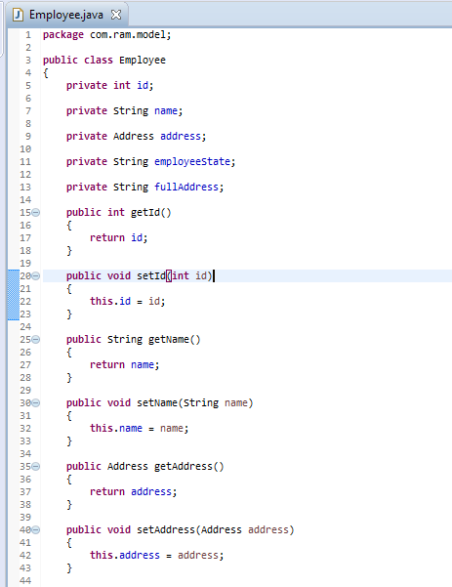
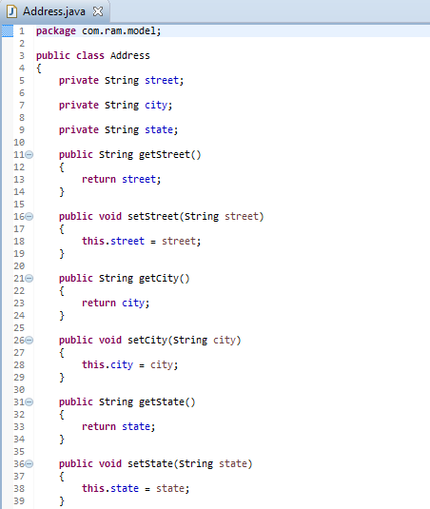
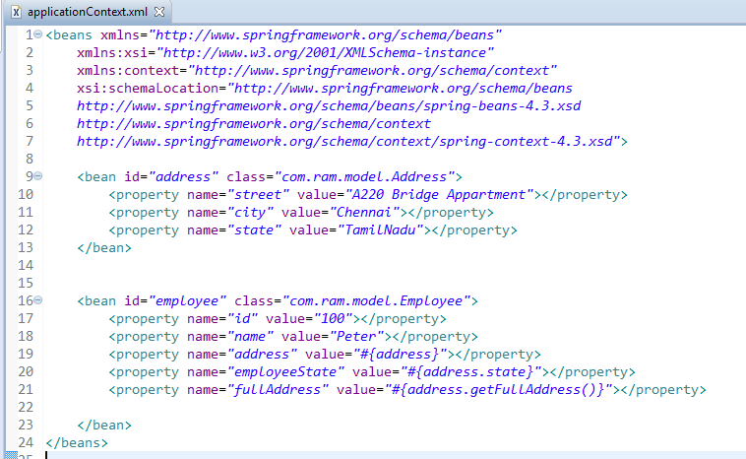
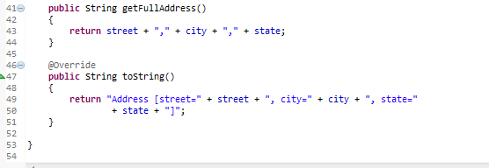
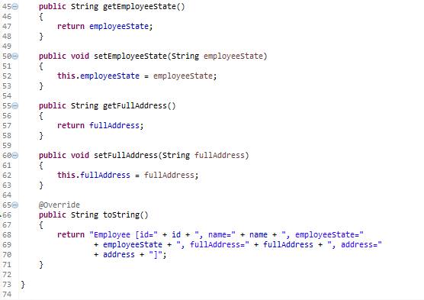
Spring EL bean reference example-XML
In Spring EL, we can reference a bean, and nested properties using a ‘dot (.)‘ symbol. For example, “bean.property_name“.

Slide 2
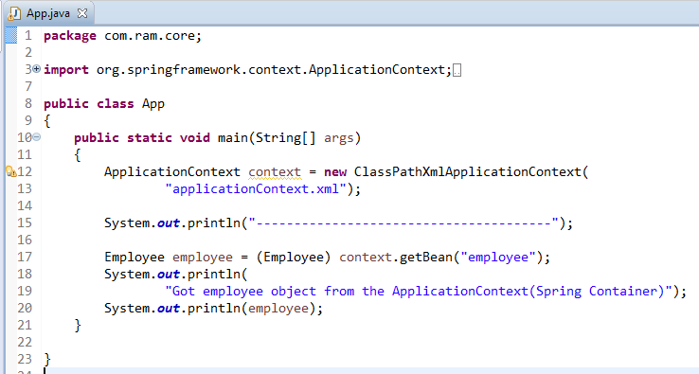

Spring EL bean reference example-XML

